Slide 1
Contour Line Deformation
Anka Chen

Slide 2
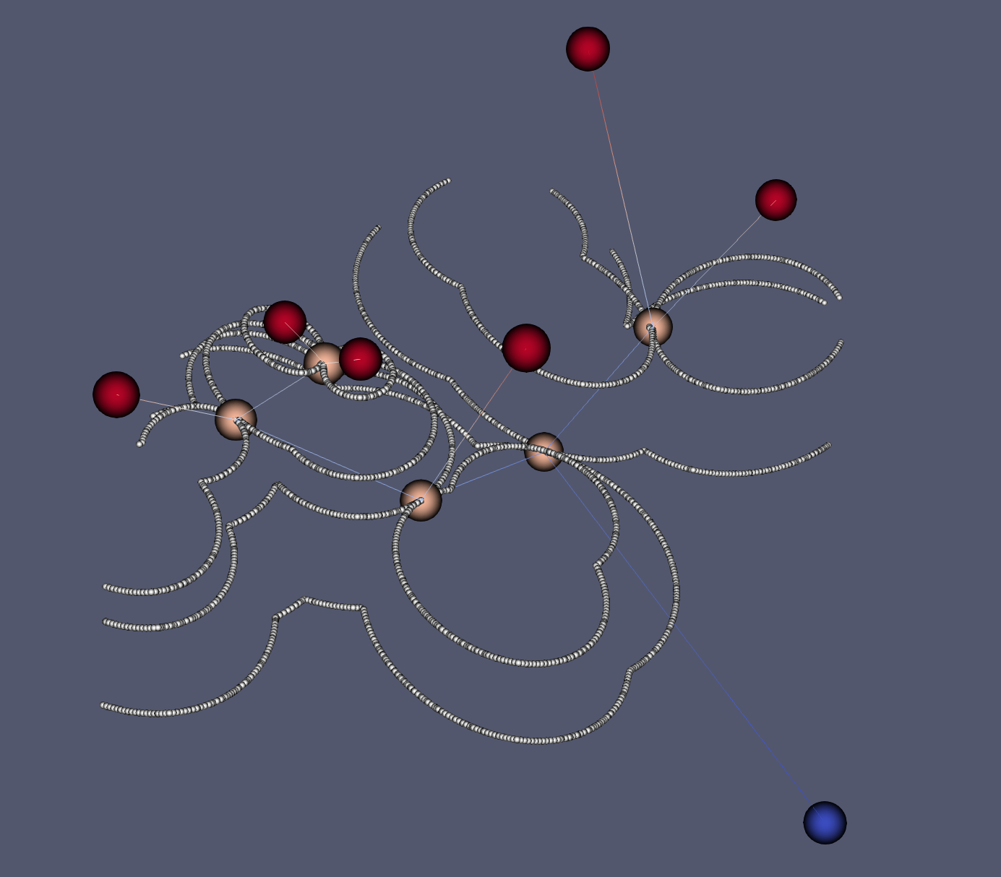
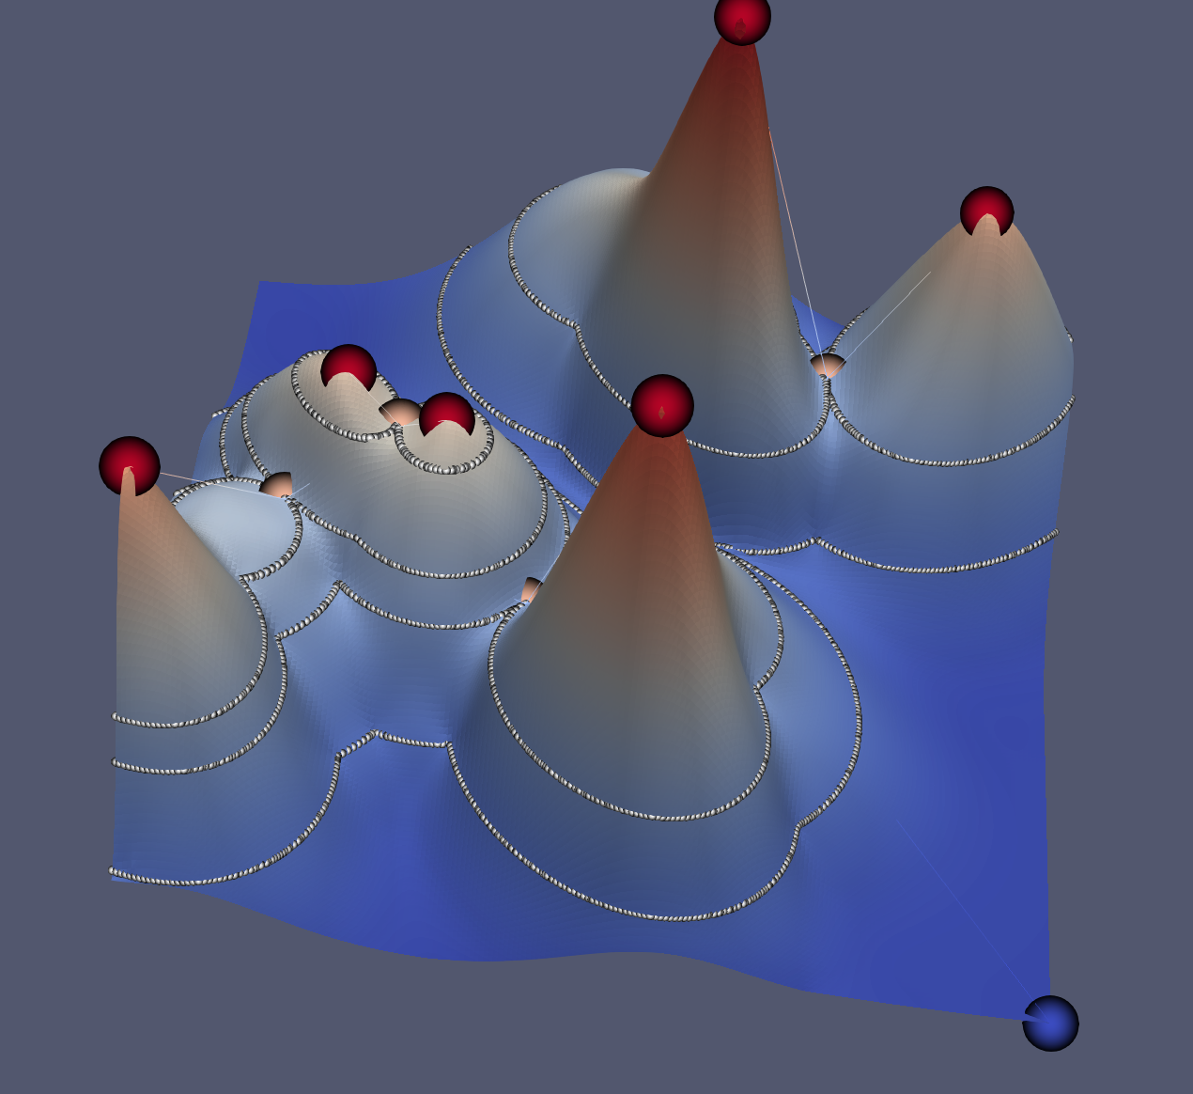
Problem definition
merge tree + contour line constraint
Reverse engineered merge tree

Slide 3
Problem definition
Contour line constraint is the key
Our previous did not solve the problem of contour line deformation problem
Initial State
End State

Slide 4
Topological Simplification
What kind of contour line deformation do we need to deal with?
Answer is rather simple: we are only interested in certain types of contour line, that is, where two separate component in the sublevel set merge
Saddle point/leaf node on the merge tree

Slide 5
Topological Simplification
And the types of deformation is also limited
homeomorphic deformation
merge
Split

Slide 6
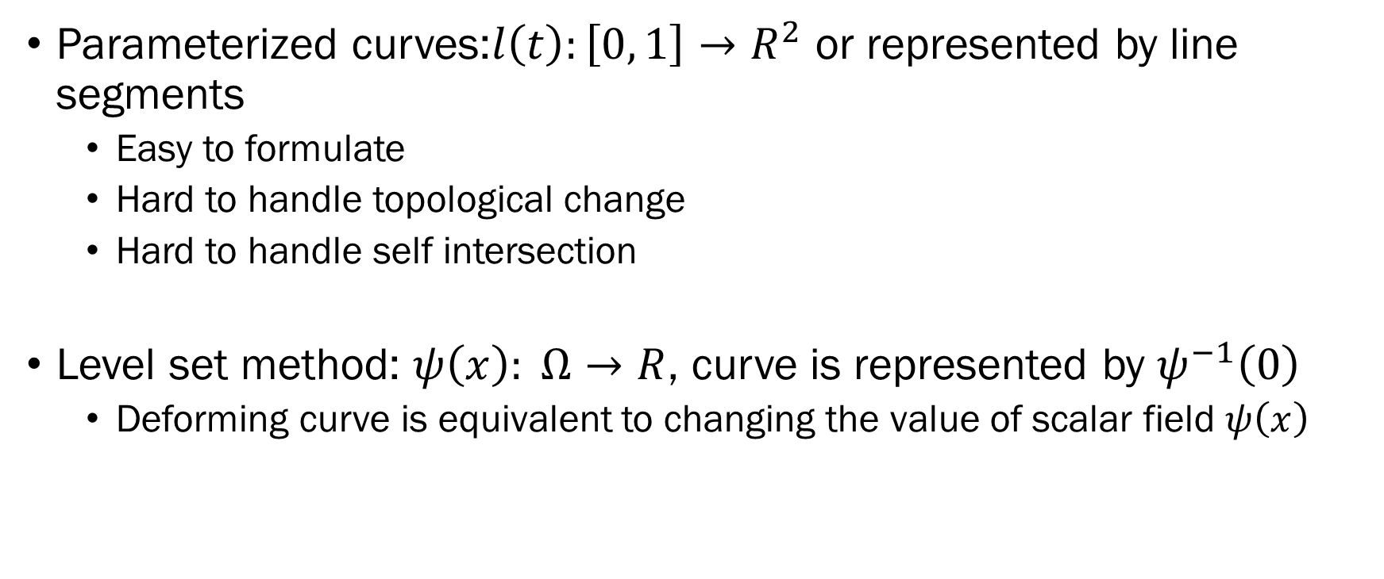
Ways to descript edge deformation
Parameterized curves:$l\left(t\right):\left[0, 1\right]→R^{2}$ or represented by line segments
Easy to formulate
Hard to handle topological change
Hard to handle self intersection
Level set method: $ψ\left(x\right): Ω→R$, curve is represented by $ψ^{−1}\left(0\right)$
Deforming curve is equivalent to changing the value of scalar field $ψ\left(x\right)$

Slide 7
Related work on Level Set Evolution
Li C, Xu C, Gui C, et al. Distance regularized level set evolution and its application to image segmentation[J]. IEEE transactions on image processing, 2010, 19(12): 3243-3254.
Osher S, Sethian J A. Fronts propagating with curvature-dependent speed: Algorithms based on Hamilton-Jacobi formulations[J]. Journal of computational physics, 1988, 79(1): 12-49.
Fahmi R, Farag A A. A global-to-local 2D shape registration in implicit spaces using level sets[C]//2007 IEEE International Conference on Image Processing. IEEE, 2007, 6: VI-237-VI-240.

Slide 8

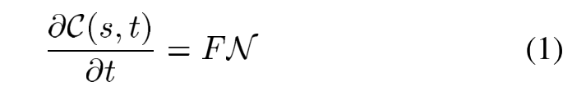

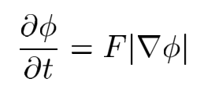

Related work on Level Set Evolution
Parameterized curves evaluation:
Its curve evolution can be expressed as:
Where F is the speed function that controls the motion of the contour, and N is the inward normal vector to the curve C.
The curve evolution in (1) in terms of a parameterized con- tour can be converted to a level set formulation by embedding the dynamic contour as the zero level set of a time dependent LSF:
the inward normal vector can be expressed as

Slide 9
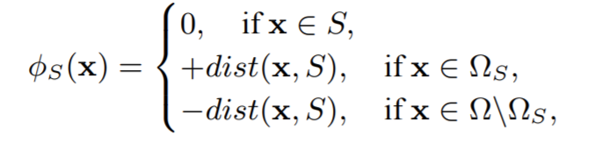
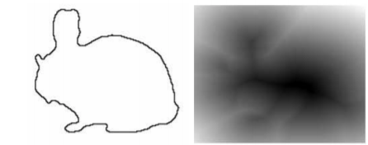
Related work on Level Set Evolution
Constructing LSF:
Signed distance function (SDF)

Slide 10
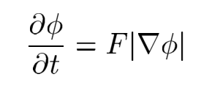
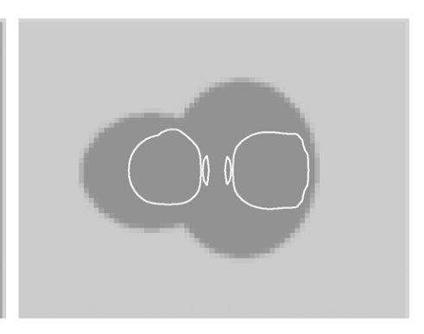
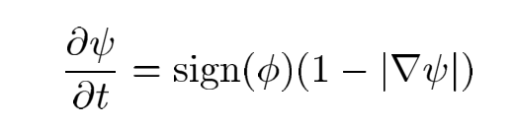


Signed distance function evaluation
$φ$ = $φ$ + $λ\frac{∂φ}{∂t}$
Problem: $φ$ = $φ$ + $λ\frac{∂φ}{∂t}$ is no longer a SDF
Irregularity
Solution reinitialization

Slide 11

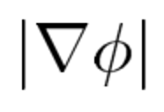

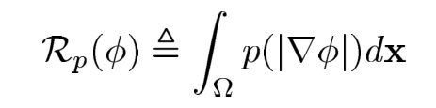
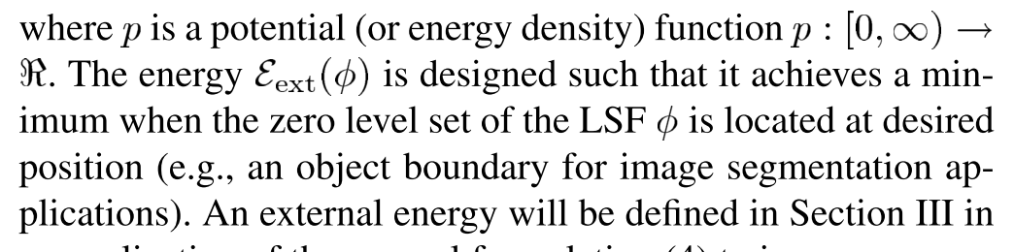
DRLSE
Property of SDF:
DRLSE: added a energy term that force the to be 1

Slide 12
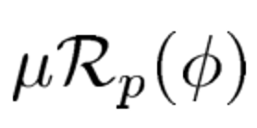
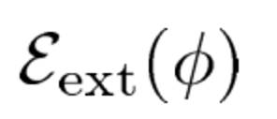
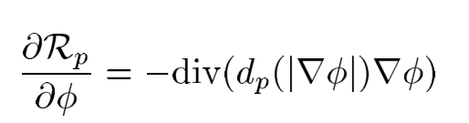
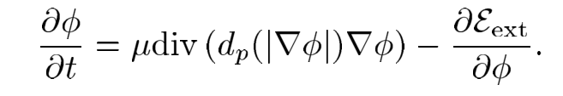
DRLSE
Actually the solution is quite simple, just add the derivative of to derivative of

Slide 13
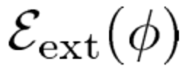
The key problem boils down to construct a
=
Target shape term
Contact term (force contour lines not to touch each other)
Connecting term (contour line must meet at saddle point)
Nesting constraint: iterating:
Starting at lower contour lines, first establish lower contour line, then use
Lower contour line as the contact constraint of deforming higher contour line

